Slide 1
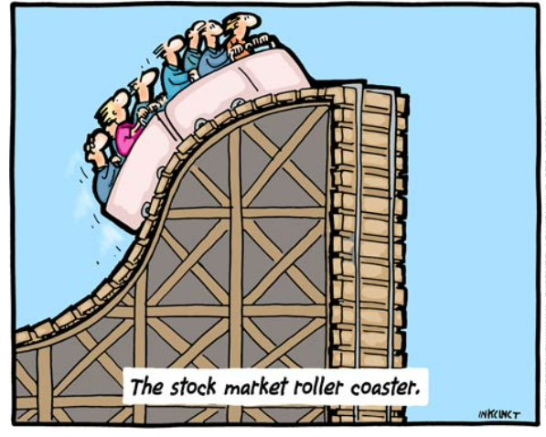
MODULE 3: S&p 500 & Dow JONES pair TRADING clustering
University of Bern, CAS in Applied Data Science 25 November 2021
Thomas parmentier
Source: Financial times, April 2008

Slide 2
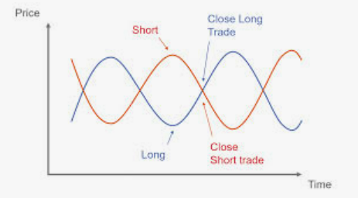
Project objectives
Research objective:
Find stocks to go long and short based on clusters and select the best methodology amongst the two followings:
-K means clustering
-Hierarchical clustering
Back-test the performance against based on Sharpe Ratio
Quantopian Lectures Saved (github.com)
Abstract:
Pairs trading is a strategy in which a trader buys one asset while shorting another. The main premise of the trade is that when the two pairs diverge, they will likely converge again resulting in profit for the trader.
Pair Trading will work if you choose the right assets to form a pair. Clustering can help identifying stocks for a pair trade.
GitHub - parment1/Project-M1-M2

Slide 3
Simplified work flow
K-means Clustering
Historical price time serie
Data exploration and cleaning
Scaling the data
Find cointegrated pairs
Backtesting
Hierarchical Clustering

Slide 4
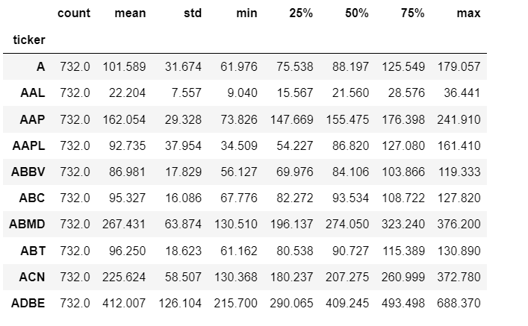
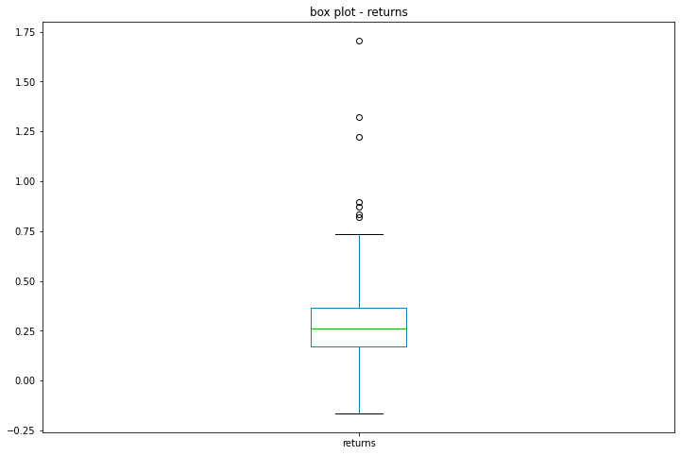
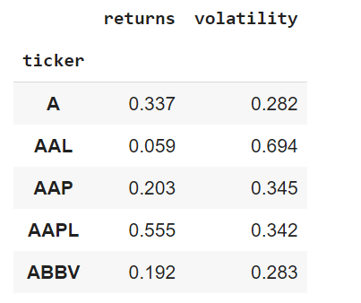
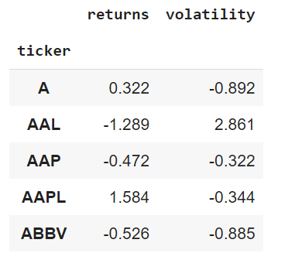
Data set description
Descriptive analysis
We use panda describe method to analyse our dataset. We see a wide in the raw data
We will transform the data by first calculate the return and volatility and then by scaling them using StandardScaler
Annualized returns / vol
Scaled data

Slide 5
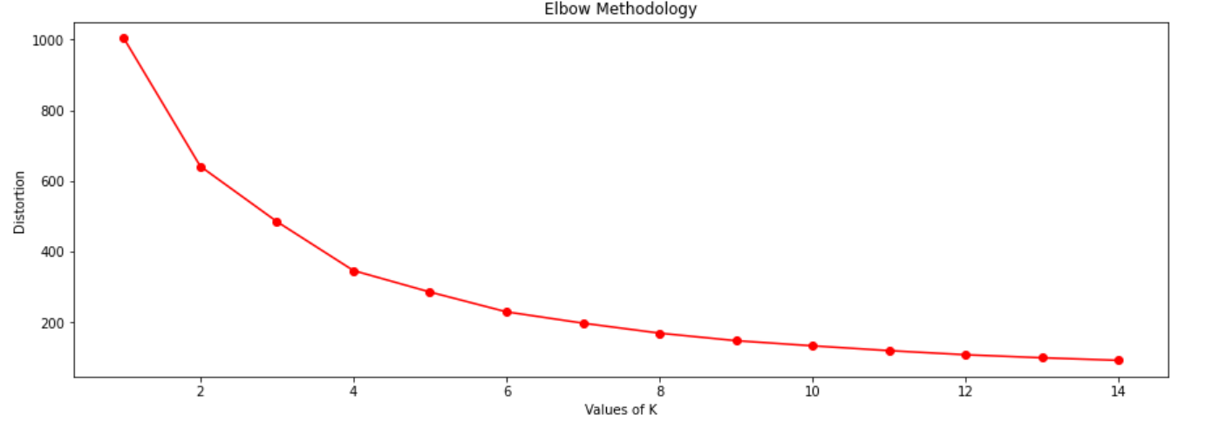
METHODOLOGY 1: K-means clustering: Elbow method
We use panda the elbow method to visualize the number of clusters
We verify the visualization using KneeLocator, which gives us 4 clusters
We cross-check with the silhouette method

Slide 6
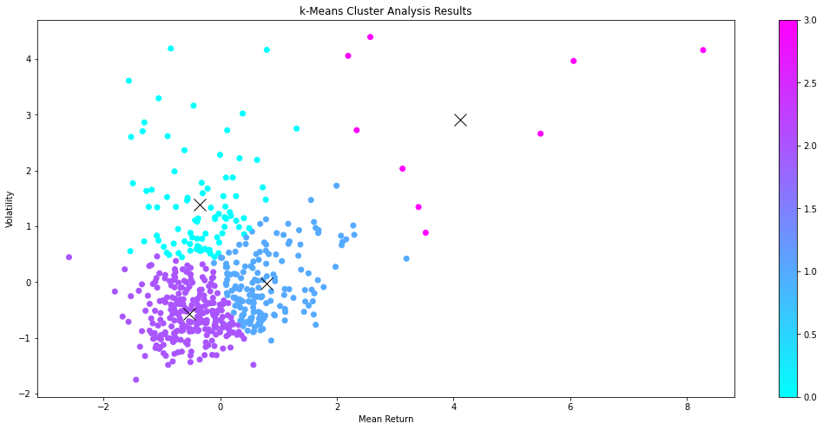
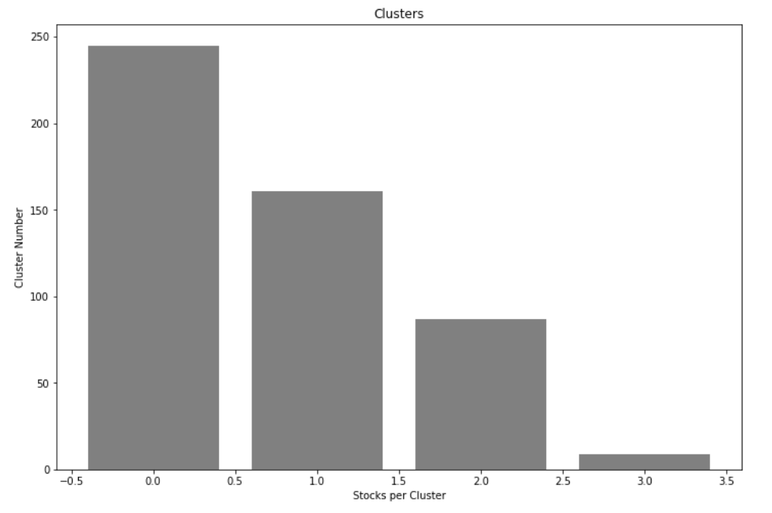
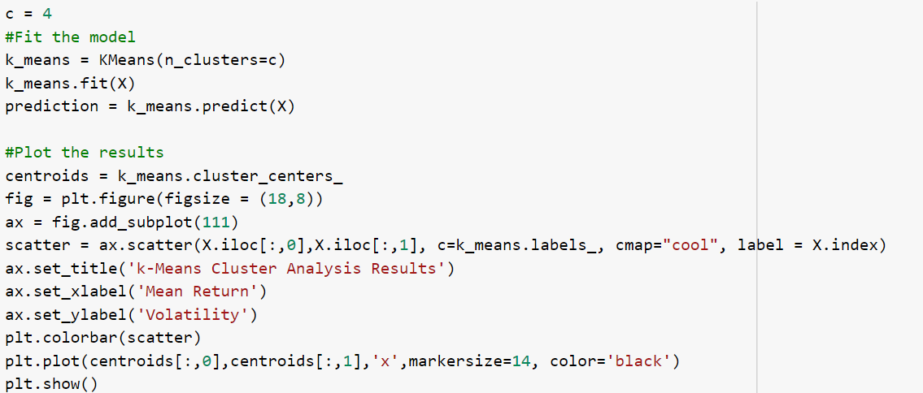
METHODOLOGY 1: K-Means clustering visualization

Slide 7
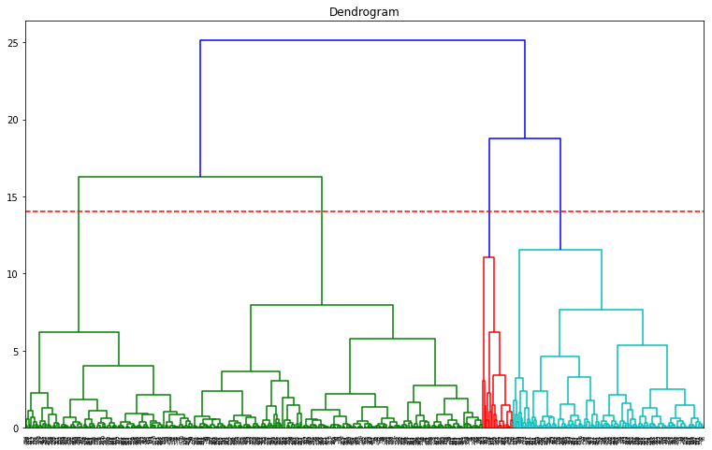
METHODOLOGY 2: Hierarchical clustering - Dendrogram

Slide 8
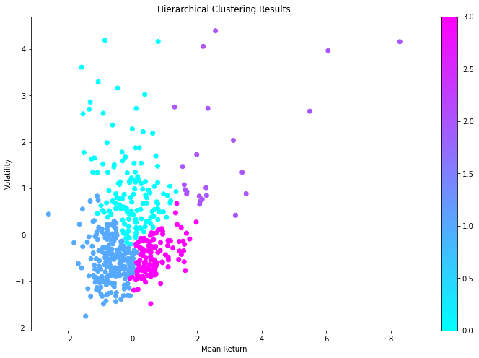

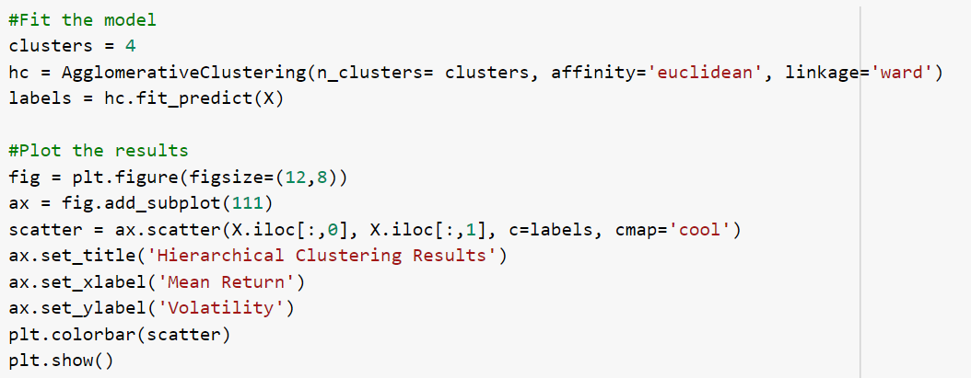
METHODOLOGY 2: Hierarchical clustering visualizations
We use the silhouette score to select the clustering approach
The K-Means gives us 4 clusters for more than 90 000 pairs

Slide 9
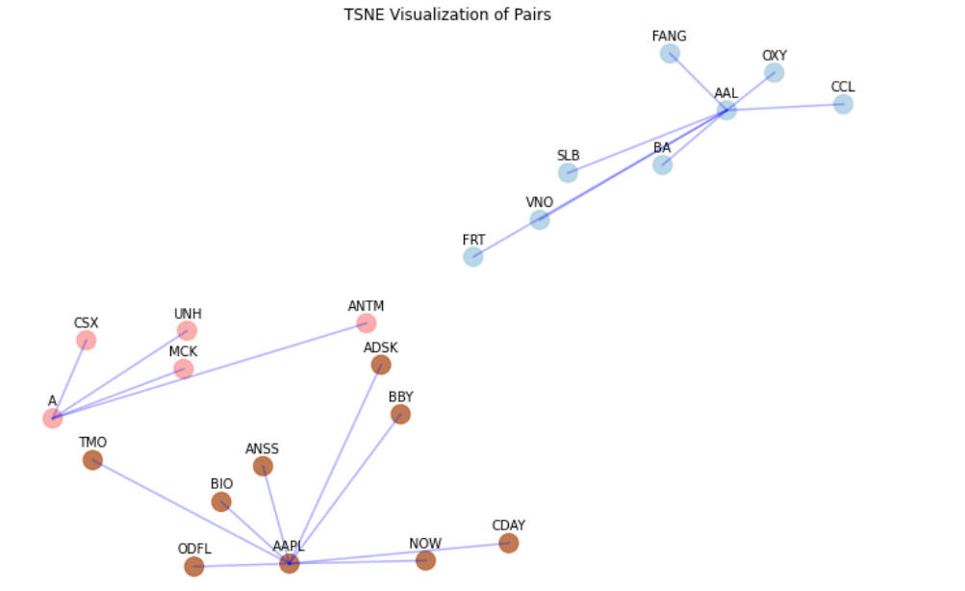
Visualizations of trading pairs

Slide 10
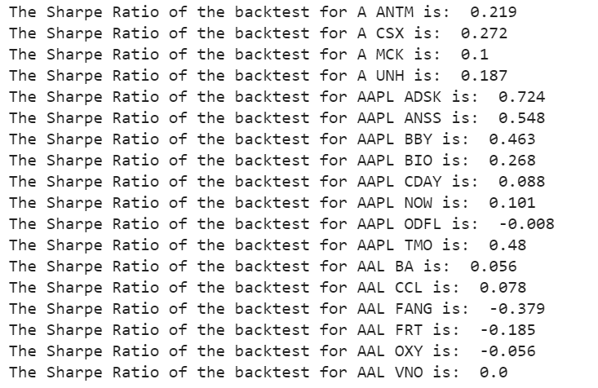
Backtesting of pairs
We take the spread between the long and the short legs and look at the performance based on the sharpe ratio
Best pair trade is APPL vs AutoDesk
Next steps:
Look at other clustering algorithm such as Affinity Propagation Clustering.
Check for overfitting, look ahead bias and P-hacking
Backtesting on a larger timeframe

Slide 11
References
https://pypi.org/project/kneed/#find-knee
Quantopian Lectures Saved (github.com)
https://raghavan.usc.edu//papers/kneedle-simplex11.pdf

